Slide 1
Nonclassicality, quasiprobabilities and weak values explored in neutron interferometry
Ismaele Vincent Masiello
Neutron and Quantum Physics
Atominstitut
TU Wien, Austria

Slide 2
Neutron Interferometry Group
Yuji Hasegawa (Professor)
Stephan Sponar (Professor)
Hartmut Lemmel (Instrument responsible)
Andreas Dvorak (PhD student)
Florian Engel (PhD student)
Ismaele Vincent Masiello (PhD student)
Kazuma Obigane (PhD student)

Slide 3
Overview
Introduction
Nonclassicality
Quasiprobabilities and weak values
Experimental results

Slide 5
Introduction

Slide 6
Motivation and goal
Quantum mechanics exhibits features with no classical counterpart.

Slide 7
Motivation and goal
Quantum mechanics exhibits features with no classical counterpart.
However, not all quantum mechanics is non-classical and identifying the classical/quantum boundary is of importance.

Slide 8
Motivation and goal
Quantum mechanics exhibits features with no classical counterpart.
However, not all quantum mechanics is non-classical and identifying the classical/quantum boundary is of importance.
Quasiprobability representations and weak values provide a valuable tool to probe such boundaries.

Slide 9





Neutron Mach-Zehnder interferometer
Neutron

Slide 10
Neutron Mach-Zehnder interferometer
Path
superposition
2
1

Slide 11
Neutron Mach-Zehnder interferometer
Phase shift

Slide 12
Neutron Mach-Zehnder interferometer
Path
recombination
?
?

Slide 13
Neutron Mach-Zehnder interferometer
Interference

Slide 14
Neutron Mach-Zehnder interferometer
Why neutron interferometry?
Interference is intrinsically a single-massive-particle phenomenon.
Matter-wave interferometry at room temperature and ambient pressure, with macroscopic beam separation and high contrast.
Manipulation of several degrees of freedom (path, spin, energy).
Sponar, S., Sedmik, R. I., Pitschmann, M., Abele, H. & Hasegawa, Y. Tests of fundamental quantum mechanics and dark interactions with low-energy neutrons. Nat. Rev. Phys. 3, 309–327 (2021).

Slide 15
Nonclassicality

Slide 16
Preparation and Measurement
Preparation (P)

Slide 17
Preparation and Measurement
Preparation (P)
System

Slide 18
Preparation and Measurement
Preparation (P)
Measurement (M)
1
2
3
...
n
System

Slide 19
Preparation and Measurement
Preparation (P)
Measurement (M)
1
2
3
t
1
2
3
...
n

Slide 20
Preparation and Measurement
Preparation (P)
Measurement (M)
1
2
3
t
1
2
3
...
n
Outcome probabilities:

Slide 21
Preparation and Measurement
Preparation (Pi)
Measurement (Mj)
1
2
3
t
1
2
3
...
n
P3
M2
M3
P2
...
...
P1
Pr
M1
Mm
Outcome probabilities:

Slide 22
A classical experiment
Preparation (Pi)
Measurement (Mj)
1
2
3
...
n
P3
System
M3
P2
...
M2
...
P1
Pr
M1
Mm
Defined set of properties:

Slide 23
A classical experiment
Preparation (Pi)
Measurement (Mj)
1
2
3
...
n
P3
M2
M3
P2
...
...
P1
Pr
M1
Mm
Defined set of properties:

Slide 24
A classical experiment
Preparation (Pi)
Measurement (Mj)
1
2
3
...
n
P3
M2
M3
P2
...
...
P1
Pr
M1
Mm
Defined set of properties:

Slide 25
A classical experiment
Preparation (Pi)
Measurement (Mj)
1
2
t
2
3
...
n
P3
System
M3
P2
...
M2
...
P1
Pr
M1
Mm
100%

Slide 26
A classical experiment
Preparation (Pi)
Measurement (Mj)
1
2
3
...
n
100%
P3
M2
M3
P2
...
...
P1
Pr
M1
Mm

Slide 27
A classical experiment
Preparation (Pi)
Measurement (Mj)
1
2
3
t
2
3
...
n
P3
System
M3
P2
...
M2
...
P1
Pr
M1
Mm
75%
25%

Slide 28
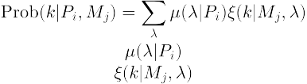
A classical experiment
Probability distribution:
Preparation (Pi)
Measurement (Mj)
1
2
3
t
2
3
...
n
P3
System
M3
P2
...
M2
...
P1
Pr
M1
Mm
75%
25%

Slide 29
A classical experiment
Probability distribution:
Preparation (Pi)
Measurement (Mj)
1
2
3
...
n
25%
75%
P3
System
M3
P2
...
M2
...
P1
Pr
M1
Mm
100%

Slide 30
A classical experiment
Probability distribution:
Response function:
Preparation (Pi)
Measurement (Mj)
1
2
3
...
n
25%
75%
P3
System
M3
P2
...
M2
...
P1
Pr
M1
Mm
100%

Slide 31
A classical experiment
Probability distribution:
Response function:
Outcome probabilities:

Slide 32
A classical experiment
Preparation (P)
Measurement (Mj)
1
2
System
M1
M2
Two properties (shape, color):

Slide 33
A classical experiment
Shape (M1)
Preparation (P)
1
2
1
2
M1
M2
Two properties (shape, color):

Slide 34
A classical experiment
Color (M1)
Preparation (P)
1
2
1
2
M1
M2
Two properties (shape, color):

Slide 35
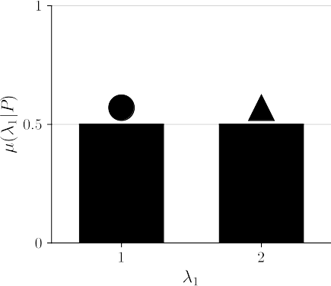
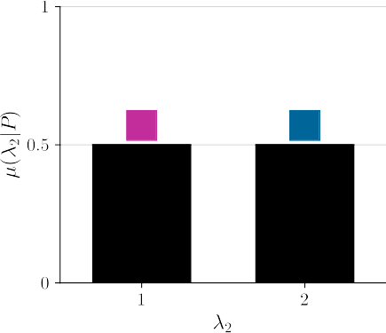
A classical experiment
50%
50%
Outcome probabilities:
50%
50%

Slide 36
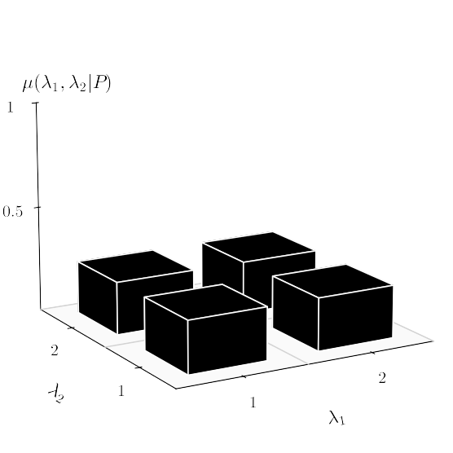
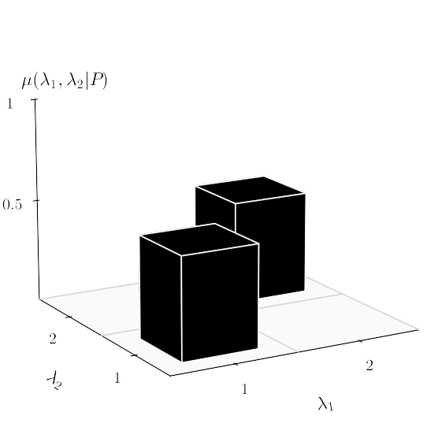
A classical experiment
Probability distribution:

Slide 37
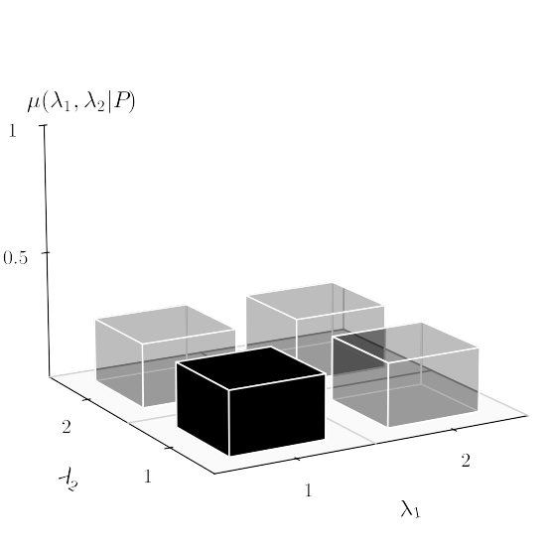
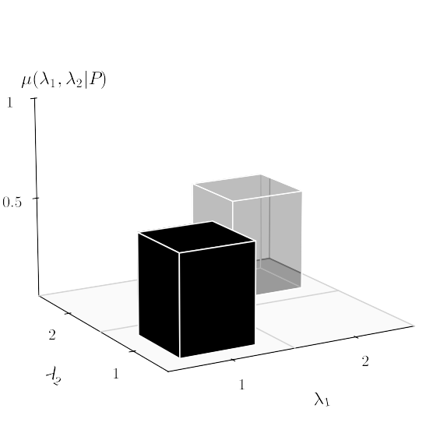
A classical experiment
Probability distribution:

Slide 38
A classical experiment
Sequential (or simultaneous) measurement
1
2
1
2
M1
M2
M1
M2

Slide 39
A classical experiment
Sequential (or simultaneous) measurement
1
2
1
2
M1
M2
M1
M2

Slide 40
A classical experiment
Sequential (or simultaneous) measurement
1
2
1
2
M1
M2
M1
M2
1

Slide 41
A classical experiment
Sequential (or simultaneous) measurement
1
2
1
2
M1
M2
M1
M2
1

Slide 42
A classical experiment
Sequential (or simultaneous) measurement
1
2
1
2
M1
M2
M1
M2
1
2

Slide 43
A classical experiment
Sequential (or simultaneous) measurement
1
2
1
2
M1
M2
M1
M2
1
2
System

Slide 44
A classical experiment
Sequential (or simultaneous) non-disturbing measurement
1
2
1
2
M1
M2
M1
M2
1
2
System

Slide 45
A classical experiment
Noncontextuality:
Outcome probabilities for non-disturbing measurements:

Slide 46
A classical experiment
Outcome probabilities for non-disturbing measurements:

Slide 47

A classical experiment
Outcome probabilities for non-disturbing measurements:

Slide 48


A quantum experiment
Preparation (P)
Measurement (Mj)
1
2
3
...
n
System
Set of undefined properties:

Slide 49
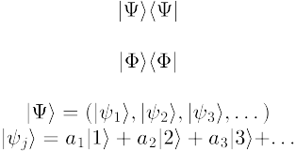
A quantum experiment
Preparation (P)
Measurement (Mj)
1
2
3
...
n
System
Set of undefined properties:
Superposition:

Slide 50
A quantum experiment
Pure state:
Preparation (P)
Measurement (Mj)
1
2
3
...
n
System
100%

Slide 51

A quantum experiment
Pure state:
Projective measurement:
Preparation (P)
Measurement (Mj)
1
2
3
...
n
System
100%

Slide 52

A quantum experiment
Pure state:
Projective measurement:
Preparation (P)
Measurement (Mj)
1
2
3
...
n
25%
75%
Outcome probabilities:

Slide 53
A quantum experiment
Pure state:
Projective measurement:
Preparation (P)
Measurement (Mj)
1
2
3
...
n
25%
75%
Is quantum mechanics secretly classical?
Outcome probabilities:

Slide 54
Is quantum mechanics classical?
Pure state:
Preparation (P)
Measurement (Mj)
1
2
3
...
n
System
100%

Slide 55
Is quantum mechanics classical?
Probability distribution:
Preparation (P)
Measurement (Mj)
1
2
3
t
2
3
...
n
System
75%
25%

Slide 56
Neutron interferometry test of nonclassicality
Neutron
Interferometer:

Slide 57

Neutron interferometry test of nonclassicality
Neutron
Interferometer:
Preparation (P)

Slide 58
Neutron interferometry test of nonclassicality
Neutron
Interferometer:
1
2
Phase
π/4
-π/4
M1
M2
Preparation (P)
Path (M1,M2)

Slide 59
Neutron interferometry test of nonclassicality
Neutron
Interferometer:
1
2
1
2
Phase
Direction
π/4
-π/4
x
y
M1
M2
M3
M4
Preparation (P)
Path (M1,M2)
Spin (M3,M4)

Slide 60
Neutron interferometry test of nonclassicality
Measurements:
M1
M2
M3
M4
1
2
1
2
Phase
Direction
π/4
-π/4
x
y
M1
M2
M3
M4
Preparation (P)
Path (M1,M2)
Spin (M3,M4)

Slide 61

Neutron interferometry test of nonclassicality
Measurements:
M1
M2
Disturbing
M3
M4
1
2
1
2
Phase
Direction
π/4
-π/4
x
y
M1
M2
M3
M4
Preparation (P)
Path (M1,M2)
Spin (M3,M4)

Slide 62

Neutron interferometry test of nonclassicality
Measurements:
M1
M2
Disturbing
Non-disturbing
M3
M4
1
2
1
2
Phase
Direction
π/4
-π/4
x
y
M1
M2
M3
M4
Preparation (P)
Path (M1,M2)
Spin (M3,M4)

Slide 63
Neutron interferometry test of nonclassicality
Measurements:
M1
M2
Disturbing
Non-disturbing
M3
M4
1
2
1
2
Phase
Direction
π/4
-π/4
x
y
M1
M2
M3
M4
Preparation (P)
Path (M1,M2)
Spin (M3,M4)
Outcome probabilities:

Slide 64
Is quantum mechanics classical?
Outcome probabilities:
?

Slide 65
Is quantum mechanics classical?
Outcomes correlations:
Clauser–Horne–Shimony–Holt (CHSH) inequality:
Eperimental results:
...No!

Slide 66
Is quantum mechanics classical?
Outcome probabilities:
?
...No!

Slide 67

Is quantum mechanics classical?
Outcome probabilities:

Slide 68
Is quantum mechanics classical?
Outcome probabilities:
?

Slide 69
Quasiprobability representations and weak values

Slide 70




Quasiprobability representations
Outcome probabilities:
Anomalous features:

Slide 71
Quasiprobability representations
Outcome probabilities:
Anomalous features:

Slide 72
Weak values and weak measurements

Slide 73

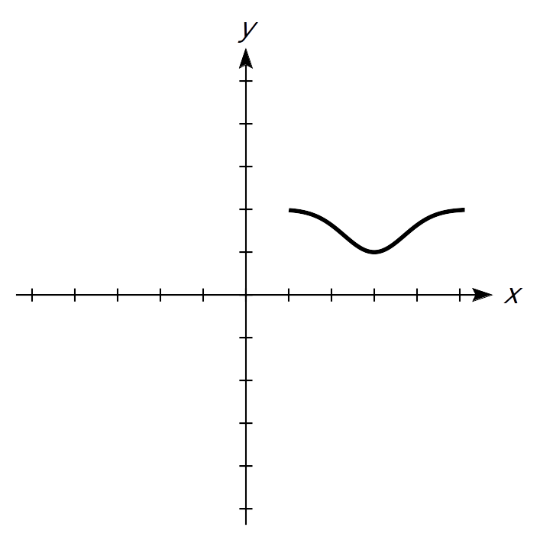
A standard (Von Neumann) measurement
Stern-Gerlach
Spin
Position

Slide 74
A standard (Von Neumann) measurement
Stern-Gerlach
Spin
Position
N
S

Slide 75
A standard (Von Neumann) measurement
Stern-Gerlach
Spin
Position
N
Interaction strength
S

Slide 76
Weak values and weak measurements
Spin
Position

Slide 77
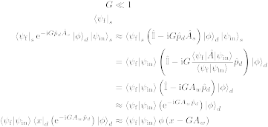
Weak values and weak measurements
Weak interaction
Spin
Position
N
S

Slide 78
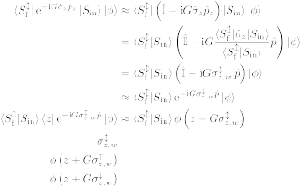

Weak values and weak measurements
Weak interaction
Spin
Position
N
Post-selection
N
S
S
Spin weak value:

Slide 79

Weak values and weak measurements

Slide 80


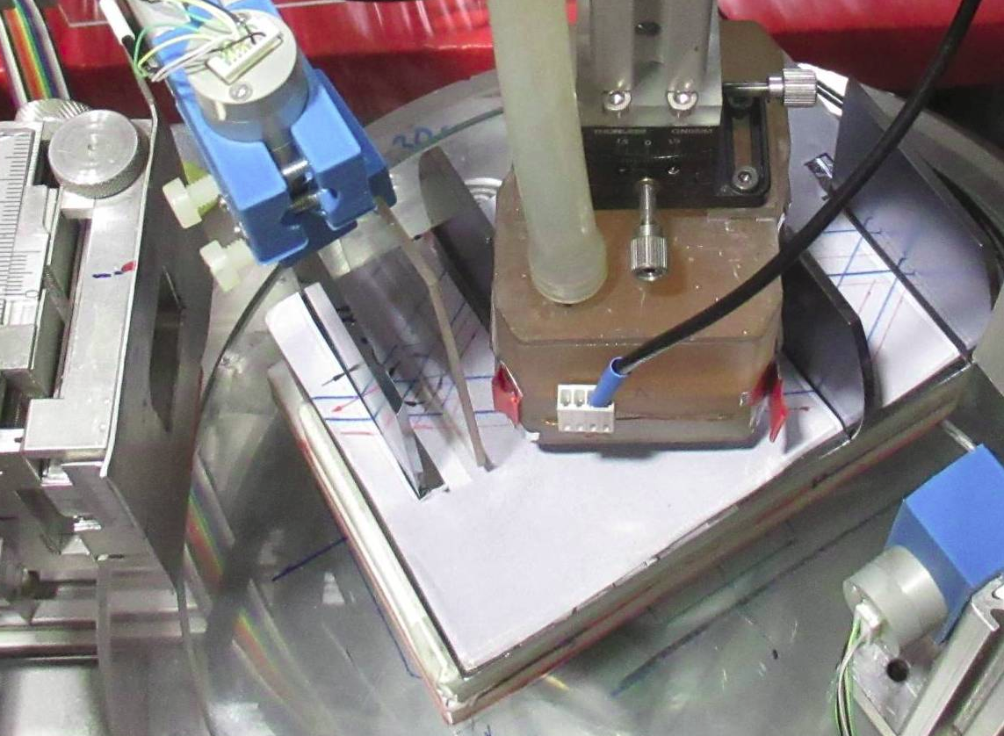
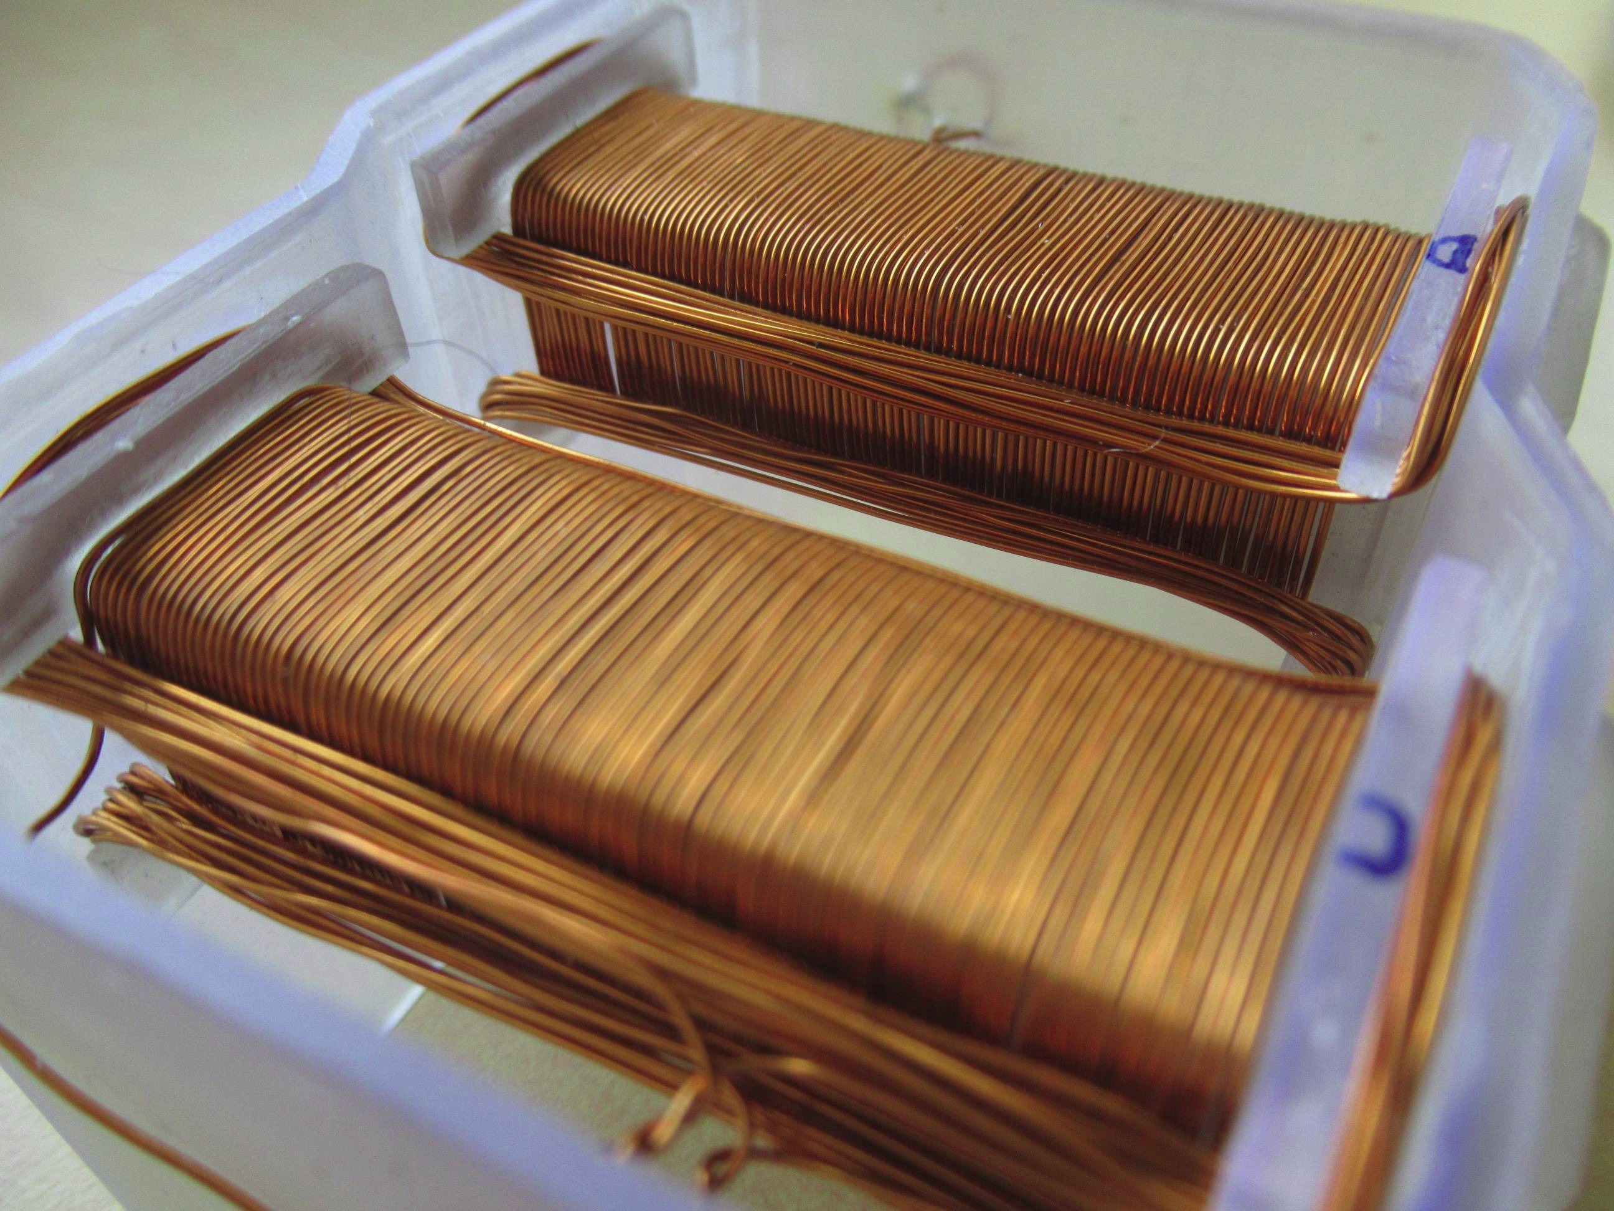
Weak interaction without meter state
+ −
2
7
4
8
6
1
5
5
y
3
z
x
6
4
6
5
5
3

Slide 81
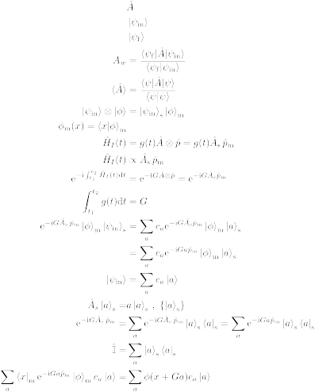
Weak measurements
System + meter(s):
Weak interaction:
Post-selection:

Slide 82
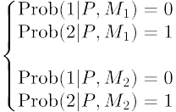
A classical experiment
100%
Outcome probabilities:
100%

Slide 83
A quantum experiment
Pure state:
Projective measurement:
Preparation (Pi)
Measurement (Mj)
1
2
3
...
n
25%
75%
P3
M2
M3
P2
...
...
P1
Pr
M1
Mm
Outcome probabilities:

Slide 84
Neutron Mach-Zehnder interferometry
Interference
??

Slide 85
Neutron Mach-Zehnder interferometry
Interference
!!

Slide 86
Neutron Mach-Zehnder interferometry

Slide 87
A classical experiment
Outcome probabilities for sharp measurements:

Slide 88
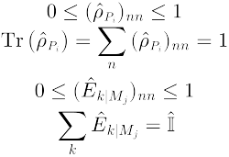


A quantum experiment
Density matrix for P:
POVM for M:
Outcome probabilities:
Outcome probabilities for non-disturbing joint measurements:

